Slide 1
Plie Key Summary Data
Achilles tendinopathy in dancers

Slide 2
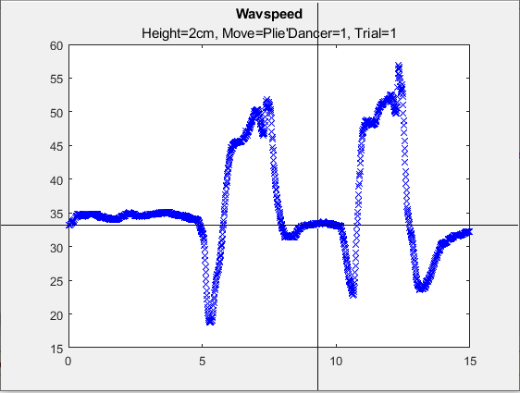
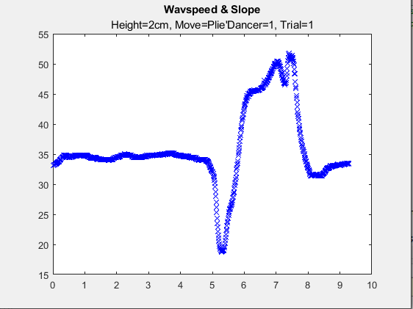
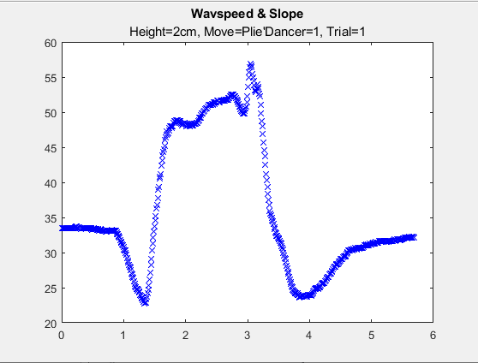
Each Rep
Data was collected on three dancers, on two separate days. When collecting the data, the instrumentation was placed at three different heights, and in each trial, the dancer did two plies with a brief pause in between. Each plie was split to be its own data set. The split was done using a based on simply looking at the data. However, over multiple runs the precise point where the data was split had little effect on the summary data points.

Slide 3
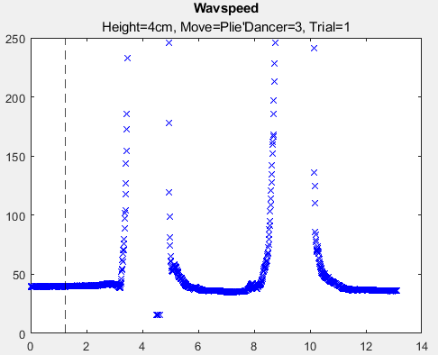
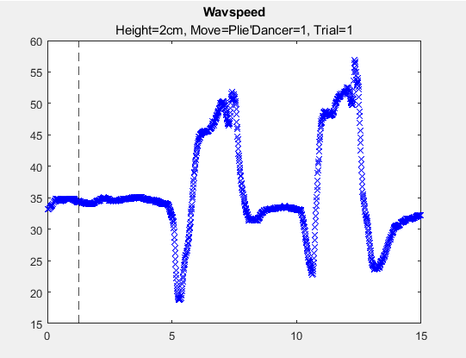
Baseline
What it is
How we calculated it
The average wave speed before the dancer begin movement.
A marker to compare the relative increase against.
The average of the first 125 wave speed measurements, approximately, the first 1.25 seconds of the trial. (Shown on the figure) The same baseline was used for both reps in each trial as it was the wave speed didn’t always return to the same point in between the plies, suggesting potentially increased stress as they waited to begin the next movement.

Slide 4
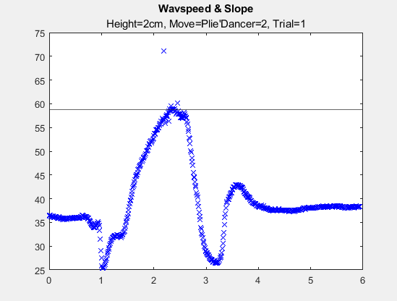
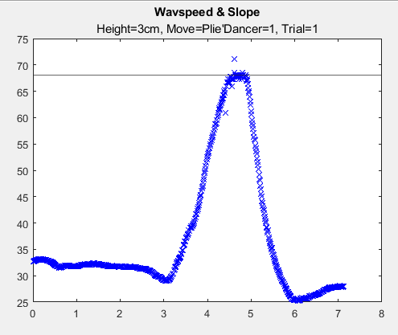
Peak Data
What it is
How we calculated it
The highest point in the data, or the maximum wave speed in each rep.
The average of the highest 8 wave speeds in a rep were used to calculate the average peak (used in later calculations) and the standard deviation of such. This was done so an outlier wouldn’t skew the results of the data. Only 8 points were used as the smoothest plies had a relatively consistent curve, compared to more a plateau shown in others, and as there were a number with gaps of data during the plie

Slide 5
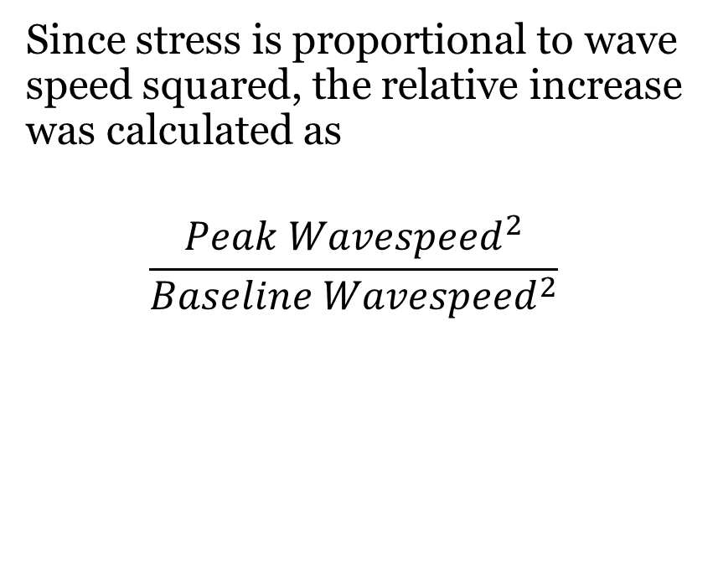
Peak to Baseline Ratio
What it is
How we calculated it
A proportional measure of how much tendon stress increased during each trial.
Since stress is proportional to wave speed squared, the relative increase was calculated as
$$\frac{Peak Wavespeed^{2}}{Baseline Wavespeed^{2}}$$

Slide 6
Slope - Midpoint
What it is
How we calculated it
The point at which the slope was calculated about
The difference between the peak and baseline was multiplied by 33% and then added to the baseline, to find the point 1/3 of the way between the peak and the baseline. The first wave speed above this value was used as the midpoint to calculated the slope.

Slide 7
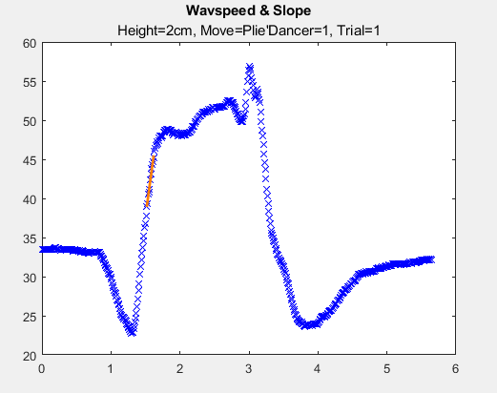
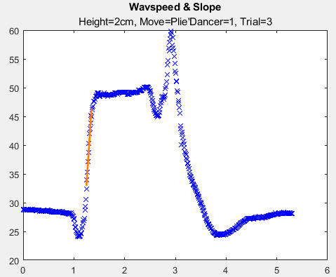
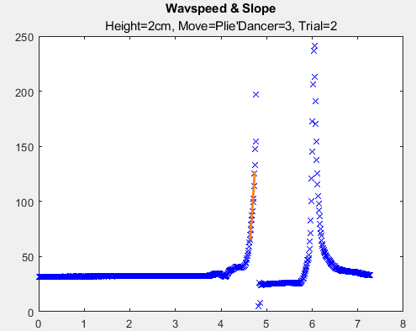
Slope
What it is
How we calculated it
The rate of increase of wave speed during each plie
MATLAB's polyfit equation was used to find the best fit for a first order polynomial (a straight line) for the wave speeds ±5 of the slope midpoint. Slope is shown in orange

Slide 8
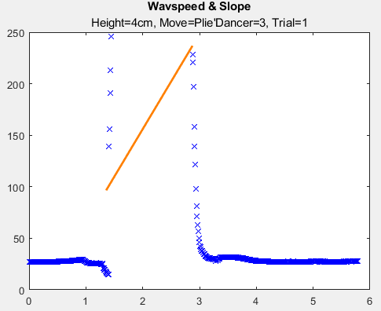
Slope – R Squared Value
What it is
How we calculated it
A measure of how well the slope matches the given data
Flag plots such as below where lack of data, resulted in an unreliable slope
Found the slope fit and compared it against the measured wave speeds over the same interval.
slope_fit = polyval(p, slopet); % fitted y values
% Compute R-squared
SS_res = sum((slopews - slope_fit).^2); % residual sum of squares
SS_tot = sum((slopews - mean(slopews)).^2); % total sum of squares
R_squared = 1 - (SS_res / SS_tot);

Slide 9
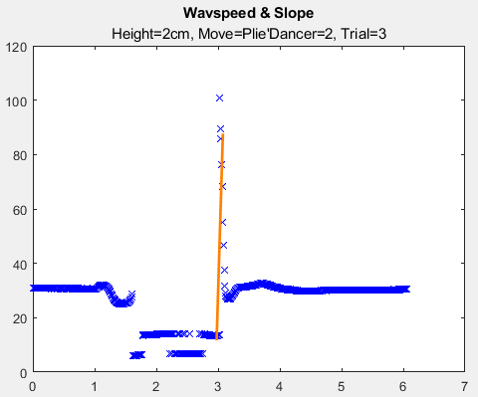
Best Height
2 cm was selected as the most reliable data set. Because 2 and 4 cm were measured on both data collection days, they provided the most data, as well as providing separate data to compare between, compared to just repetitions of the same situation. There were some points of concern within this data set, such as the one highlighted below. Seeing as the calculations didn’t account for wave speed decreasing during the plie, but this was a relatively small portion of the trials, 2cm was selected as the best option for statistical analysis.

